Slide 1
Retaining High Churn-risk Bank Customers
RE6013 Team 10
Ang Wan Qi (U1721634L)
Ma Jiebing (U1722200B)
Justin Peh (U1620687C)
Mark Wei (U1721491K)
Colin Loh (U1721073H)

Slide 2
01 What is Customer Churn?
02 Why is it important?
03 How do we define high-risk?
Colin Loh

Slide 3
Customer Churn
Loss of Existing Customers
% of customers that stopped using our products
Importance of Metric
Customer Retention Costs (CRC) is typically lower than Customer Acquisition Costs (CAC)
Reducing customer churn will thus lower overall business costs while maintaining the same volume of Assets Under Management (AUM).
Colin Loh

Slide 4
Business Problem / Opportunity Statement
Identify customers who are highly likely to churn and recommend the top personalised remedy action(s) that can make these high-risk customers stay as clients.
Colin Loh

Slide 5
Value Distribution of Variables
Colin Loh

Slide 6
01
02
03
High Net Worth
High Retain Rate
Location
High net worth individuals
(> $100,000 estimated salary)
About 80% of customers were retained
Most customers are based in France
04
05
Number of Products
Tenure Duration
About 97% of customers use either 1 or 2 products
Number of customers for each tenure duration evenly distributed.
Colin Loh

Slide 7
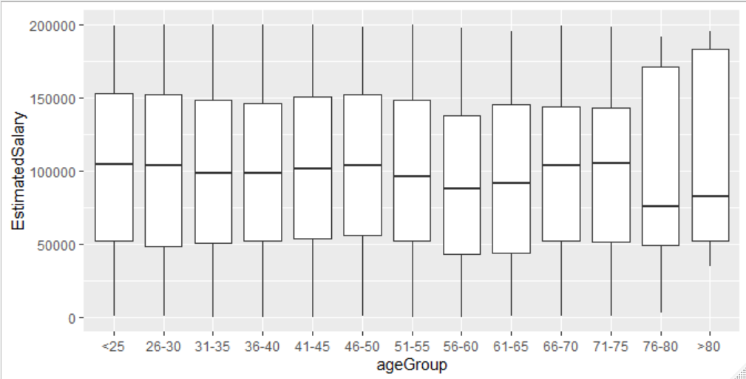
Estimated salary range of each age group
Colin Loh

Slide 8
Correlation between variables
Mark Wei

Slide 9
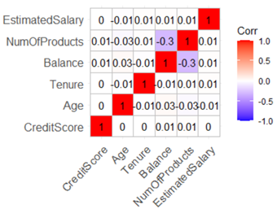
Correlation between Continuous Variables
CreditScore has little relationship with the other continuous variables
Mark Wei

Slide 10
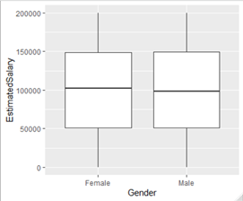
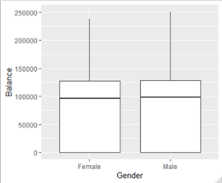
Correlation between Gender, Estimated Salary and Balance
Annual salary and bank balance are similar across both genders
Mark Wei

Slide 11
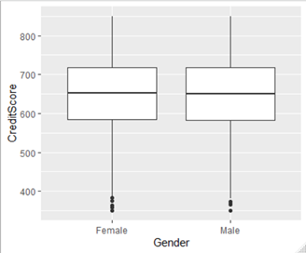
Correlation between Gender and CreditScore
Since salary and bank balances are similar across both genders, creditworthiness should likewise be similar.
Otherwise, it may suggest gender discrimination.
Given these findings, Gender can be regarded as independent from EstimatedSalary, Balance and CreditScore.
Mark Wei

Slide 12
Investigating high churn rate in Germany
Mark Wei

Slide 13
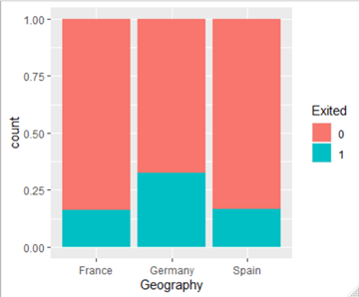
Disproportionally high churn rate in Germany
More customers exit among those whose Geography = Germany
Mark Wei

Slide 14
Comparing values distribution between countries
Histogram plots done for the following variables:
Age
Balance
Tenure
CreditScore
HasCrCard
NumOfProducts
Only NumOfProduts show significant deviation
Mark Wei

Slide 15
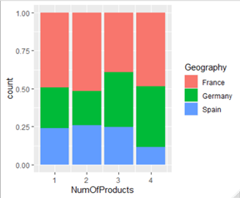
NumOfProducts histogram diagram
Germany-based clients make up 25% of all clients.
Among clients with 3 products, Germany-based clients make up 37%.
Among clients with 4 products, Germany-based clients make up 40%.
Mark Wei

Slide 16
Impact of Product Range on Churn
Justin Peh

Slide 17
Impact of our Product Range on Churn
Majority:
1 & 2 products
Number of Products Used (NumofProducts) | Customer Count (Total = 10000)
1 | 5048
2 | 4590
3 | 266
4 | 60
Justin Peh

Slide 18
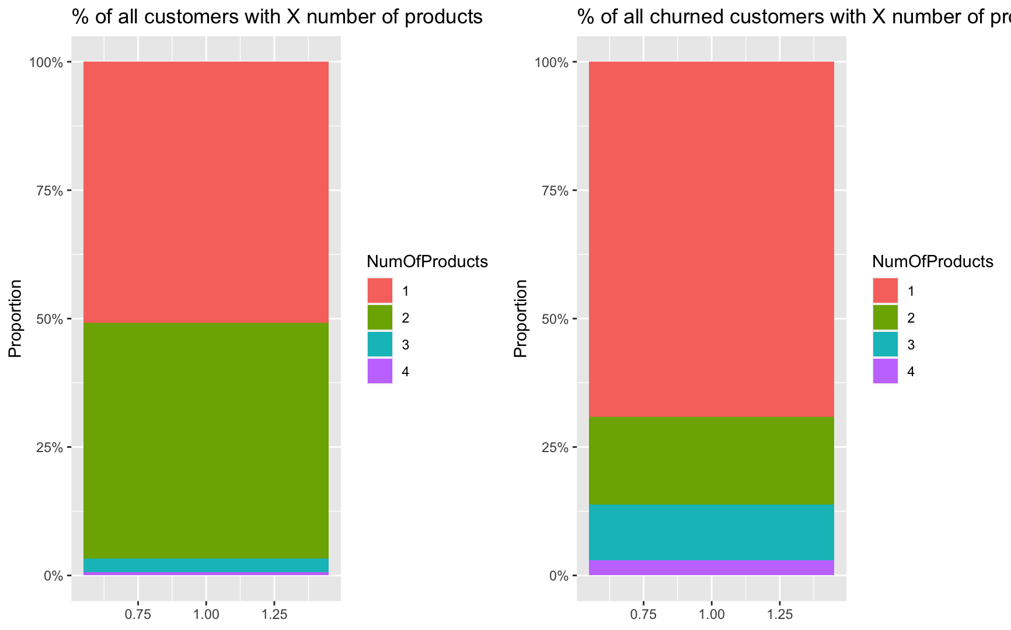
Impact of our Product Range on Churn
% of customers with X number of products
% of all churned customers with X number of products
Justin Peh

Slide 19
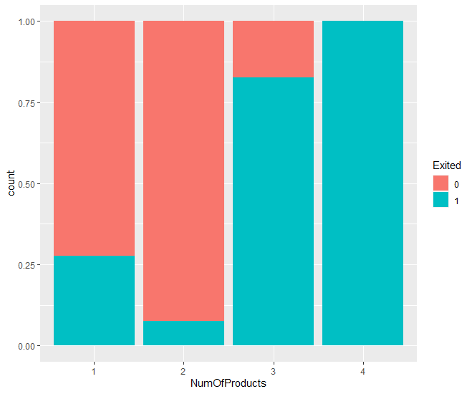
Impact of our Product Range on Churn
Subscribed to 2 products least likely to churn
2nd highest churn rate for 3 products (83% churn)
100% churn rate for 4 products
Justin Peh

Slide 20
Assumption about products used by clients
Most customers with the same number of products are using the same products.
Justin Peh

Slide 21
Most customers with 1 product are using Product A
Assumptions about products used by clients
Most customers with 2 product are using Product A and Product B
Most customers with 3 or 4 products are using Products A and B, as well as Product C (and D).
01
02
03
Justin Peh

Slide 22
Terminology
hasManyProducts == TRUE if NumOfProducts >= 3
Many-Product-Customers (MPCs): customers where hasManyProducts == TRUE
Few-Product-Customers (FPCs): customers where hasManyProducts == FALSE
Justin Peh

Slide 23
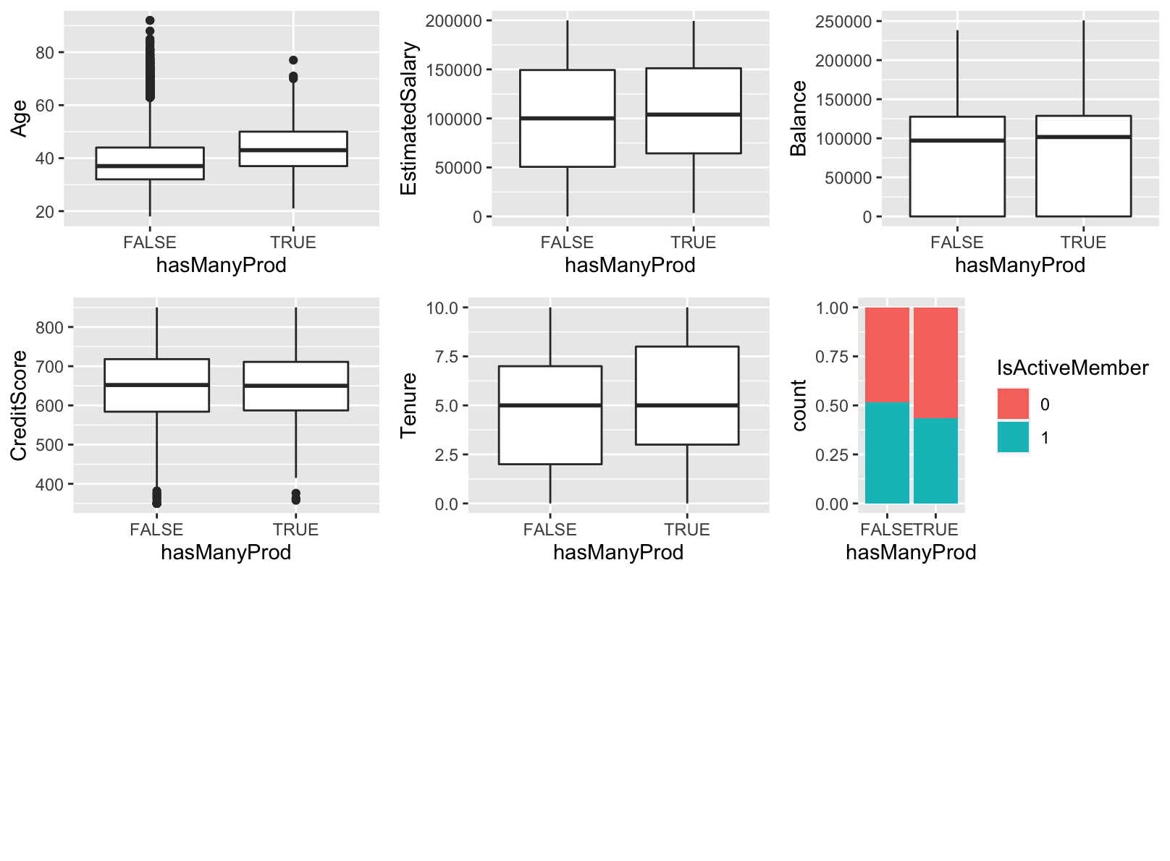
Many- vs Few-Product-Customers
MPCs are generally older
MPCs have longer tenures
Salaries, credit score, balance and proportion of active members are similar
Justin Peh

Slide 24
Hypothesis
MPCs who take up Product C and D found them unable to satisfy their financial needs --> churn
There are FPCs who took up C and D (rather than A and B) --> equally unsatisfied --> churn
Justin Peh

Slide 25
Testing our hypothesis
Created new variable: ageAtStartOfTenure (derived using Age-Tenure)
Represents age of customer when he/she first joined the bank
Justin Peh

Slide 26
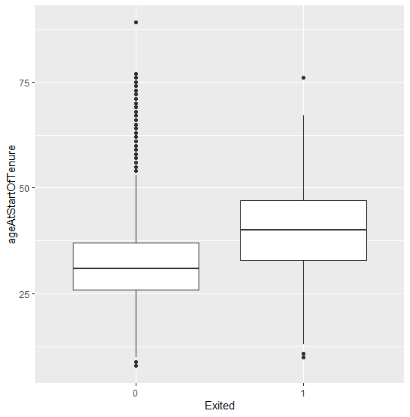
Single-Product Customers
Single-product customers who churned tended to start their tenure when they are older (mean = 40 years old) than those who remained (mean = 32 years old)
Similar to age distribution of MPCs (mean = 38.6 years old)
Justin Peh

Slide 27
Proposed theories to explain churn
Ma Jiebing

Slide 28
Possible theories
Single product churners who started their tenure late are actively comparing between banks for offerings similar to Product C or D
Higher flight risk due to intense comparison and/or Product C is inadequate by industry standards
Ma Jiebing

Slide 29
Possible theories
Product A and B are likely saving/checking accounts and bank loans --> lower customer expectations --> less dissatisfaction --> less churn
Product C and D are niche products, likely retirement plans --> more urgent financial needs --> higher expectations --> more dissatisfaction --> higher churn
Ma Jiebing

Slide 30
Impact of Customers’ Financial Habit on Churn
Ma Jiebing

Slide 31
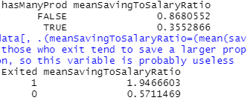
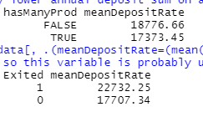
Impact of Customers’ Financial Habits on Churn
No conclusive relationship between a customer’s financial habits and their propensity to churn.
Ma Jiebing

Slide 32
Predicting Churn
Ang Wan Qi

Slide 33
How do we predict customer churn?
Logistic Regression
CART
Ang Wan Qi

Slide 34
Variables Used in Prediction
Prediction Model
Age | Gender | Balance
Geography | Credit Score | Estimated Salary
Has Credit Card | Tenure | Is Active Member
Number of Products | Age at Start of Tenure
Likely to churn
Unlikely to churn
Ang Wan Qi

Slide 35
Results for Logistics Regression
Confusion Matrix
n = 3000 | Predicted: 0 - Not Exited | Predicted: 1 - Exited
Actual: 0 - Not Exited | 2317 | 72
Actual: 1 - Exited | 376 | 235
Metric | Value
Precision | 235/(72+235) = 235/307 = 0.7654
Prevalence | (376+235)/3000 = 611/3000 = 0.2037
Accuracy | (2317+235)/3000 = 2552/3000 = 0.8507
Misclassification Error | (72+376)/3000 = 448/3000 = 0.1493
Ang Wan Qi

Slide 36
Results for CART
Confusion Matrix
Testset Accuracy
85.7%
 | Predicted 0 (Not Exited) | Predicted 1 (Exited)
Actual 0 (Not Exited) | 2317 | 72
Actual 1 (Exited) | 357 | 254
Ang Wan Qi

Slide 37
Age of Customer
Which factors have more impact on Customer Churn?
Number of Products
Age at Start of Tenure
01
02
03
Ang Wan Qi

Slide 38
Remedy Recommendation
Ang Wan Qi

Slide 39
Proposed Remedies
Target marketing efforts towards prospects between 18 to 43 years old
Improve their offerings that are targeted at clients who are > 40 years old
E.g. packaging such products with better deals
Lower priority remedy:
Close down Germany-based branches and consolidate in France
Or improve banking services in those branches
Ang Wan Qi

Slide 40
Thank you!

